Slide 1


Google Data Analytics Capstone Project
Presented By Arpita Priyadarsinee

Slide 2

1
Agenda
Business Task
Project overview & purpose
3. Data & Analysis
4. Recommendations and Actionable Steps
2
3
4

Slide 3

BUSINESS TASKS

Slide 4
Business Task
Since it was founded in 2013, Bellabeat has expanding rapidly and swiftly positioned itself as a
tech-driven wellness company for women.
Our Business Task is to analyse the fitness data to guide marketing strategies for bellabeat to
grow as a global player.
The company has 5 focus products:
Bellabeat app-
It connects to line of smart wellness products which tracks activity, sleep, stress, menstrual cycle, and mindfulness habits.
Leaf-
Classic wellness tracker can be worn as a bracelet, necklace, or clip which
connects to the app to track activities.
Time-
It provides the insights into daily wellness.
Spring-
It’s a water bottle that tracks daily water intake using smart technology
Bellabeat membership-
24/7 access to fully personalized guidance on overall which based on lifestyle and goals.

Slide 5
About Dataset
Fitbit Fitness Tracker Data was obtained from Kaggle.com
This dataset generated by respondents to a distributed survey via Amazon Mechanical Turk between 03.12.2016-05.12.2016.
Limitations:
i. Small sample size collected in 2016
ii. Limited descriptive data on the users
iii. Age, sex, career/lifestyle
Want to Analyze the Data?? FitBit Fitness Tracker Data (CC0: Public Domain, dataset made available through Mobius): License: CC0 1.0 Universal(CC0 1.0). https://www.kaggle.com/datasets/arashnic/fitbit
Public Domain Dedication : https://www.kaggle.com/datasets/arashnic/fitbit/download?datasetVersionNumber=1

Slide 6
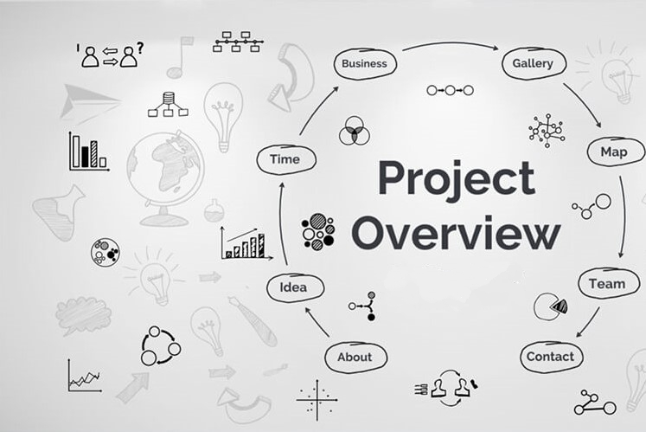
2.

Slide 7
2. Project overview & purpose
Aim of the Project- To determine how consumers use non-bella beats smart devices (i.e. Fitbit Activity Trackers & use this insights to drive for marketing strategy.
Questions:
What trends are present in...
i. Device features used?
ii. Times people record activity?
iii. Sleep delay?

Slide 8
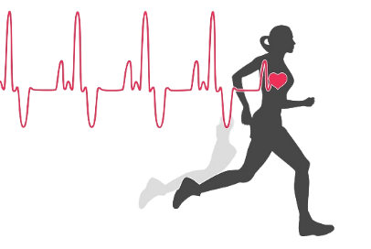
Project Background
High tech smart device company
Focused on women
Products track
Physical activities
Sleep pattern
Heart rate

Slide 9


Data Overview
Total Considered ID – 33
FitBit Fitness Tracker Data
Physical Activity
Daily Activity
Intensity
Steps
Physiology
Heart rate
Calories
Monitoring
Weight
Sleep

Slide 10

3.

Slide 11
Data Cleanup
The data was cleaned of duplicates, nulls and other common errors.
There is no information about age or DOB.
Targeted customer is only women.
Date column represent the discontinuity format as some are in dd-mm-yyyy and others are mm/dd/yyyy
There are some values which are zero total steps and activity
No. of Unique ID’s are considered different in Sleep, Heratrate_seconds and Weight Data
More data needed for complete the analysis.
Fitbit Data | Unique ID's
dailyActivity | 33
dailyCalories | 33
dailyIntensities | 33
dailySteps | 33
sleepDay | 24
weightLogInfo | 8
heartrate_seconds | 7

Slide 12
Frequency of user logged in
Highest No. of logged in- 153
Favourite day for activity - Friday

Slide 13
% of Activity in Mintues
Highest Percentage of Minutes -
81% from Sedentary Minutes
Percentage of total active minutes -
19% from VeryActive (2%),
FairlyActive (1%) &
Lightly Active (16%) Minutes

Slide 14
Average Minutes by Weekdays
Fairly Active – 14 Mins.
Very Active – 21 Mins.
Lightly Active – 193 Mins.
Sedentary – 991 Mins.

Slide 15
Day wise Avg. Steps vs Calories
Avg. No. of Steps – 7638
Avg. of Calories – 2304
Highest Steps Taken – Saturday (8326)
Highest Calories Burnt– Thursday (2376)

Slide 16
Hourly wise Avg. Steps vs Calories
Highest No. of Steps Taken – 15-20 hrs (9122)
Highest Calories burnt – 15-20 hrs (2432)

Slide 17
Calories burnt for every steps taken against Total Hours
Highest Steps Taken - 36019 against 2690 Calories Burnt
Highest Burnt Calories - 4900 against 19542 Steps
Highest Hours against Burnt Calories - 24 Hrs

Slide 18
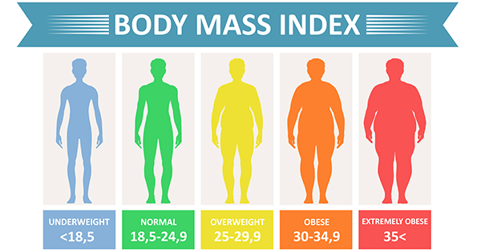
ID wise BMI Status
Healthy Category – 3 Ids
Overweight Category – 4 Ids
Obese Category – 1 Id

Slide 19
Sleep Score Status
Excellent
90-100
331
ID
Good
80-90
51
ID
ID
ID
24ID
21
Moderate
60-80
Poor
40-60
10

Slide 20
4.

Slide 21
What We have learned
Device was used more frequently and consistently to track actively rather than sleep
Users tend to tracks sleep much more on weekends(35%) than weekdays.
There wasn’t significant variation in activity tracking between weekdays & weekends.
People are active very much on weekends (Saturday) than weekdays.
In 15-20 hrs up to average 9122 steps taken to burnt the calories of 2432.
Users wouldn’t have much active minutes than sedentary minutes.
Frequency is higher on Friday as 153.

Slide 22
Real Scenario
More interested in tracking activity or in tracking sleep? One can guess hours of sleep but not count of steps.
Did consistently wearing device motivate the users to take better care for activity and sleep?
Sleep and weight data is need more data to solve.

Slide 23
Action Recommended
Encourage fitness goal
Focus on tracking activity and sleep.
Emphasis on battery life and comfortness of watch to be worn or not.
Access for any barriers to preventing users from engaging in features like weight logging, syncing with Bluetooth scales, fashionable straps.
Personalize notifications to individual fitness habits as fitness schedules.

Slide 24
Contact me
Email:
arpitapriyadarsinee01@gmail.com

